Slide 1

Town of Mount Pleasant
Budget Workshop FY 2022/2023
March 26, 2022

Slide 2
State of the Town
Proposed tax rate of 50.5 cents per $100 tax value =Est. Revenue $934,685 (FY 2022/2023)
Current FY Property tax Revenue -$886,384 (FY 2021/2022)
        $ 48,301 (increase)
Estimated Sales Tax Revenue Increase from NC $ +35,000 (FY2021/2022)
$ 83,301 (additional $)
One penny on tax rate equals $18,508
Rural Fire District Revenue (11.8/100) $717,094 (FY 2022/2023 combined property & sales tax)
  - $667,228 (FY 2021/2022)
  $ 49,866 (increase)
Various Fund Balances as of 2/28/22
Restricted Fund Balance by Policy (42%) $ 865,219
  Stabilization by State Statute (10% included in the 42% above) $ 205,982
  Estimated Unreserved Fund Balance Available $1,542,141
  (General Fund loaned $180,000 to USDA Fund for engineering fees,
  which will be reimbursed at the end of USDA project)
General Fund Checking $ 290,940
Powell Bill Fund $ 69,786
Park Development $ 33,692
Fire Capital Reserve –Vehicles $ 246,157
Fire Capital Project-Station $ 242,555
Capital Reserve Equipment/Law Enforcement Vehicle $ 56,624
Escrow (Sidewalks) $ 6,302
Water & Sewer Money Market $ 819,596
  ($335,389 obligated Town portion to FEMA Dam Project)
Water & Sewer Checking $ 253,436
Future retiree insurance fund $ 14,407
Manhole Repair/USDA Payment Reserve $ 84,637

Slide 5

Outstanding Debt at end of FY22/23
Debt | Fund | Balance (as of June 30, 2022) | Annual Debt Payment | Debt Retired
DEQ Loan | Water/Sewer | $149,189 | $76,983 | 2024
WSACC loan for North Drive Tank (Town assumed loan 2017) | Water/Sewer | $117,925 | $62,099 | 2024
Public Works Facility | General | $70,000 | $48,341 | 2024
Fire Dept New Tanker | General | $67,019 | $30,821 | 2024
SMEAL Fire Truck | General | $425,093 | $48,119 | 2035
TOTALS |  | $829,826 | $266,363
ALL OUR DEBT RETIRES IN CALENDAR YEAR 2024
with the exception of the new Smeal Fire Truck.
In 2024, we will retire approximately $218,244 per year in annual debt!
Notes:
5

Slide 6

Requests
for
Fiscal Year 2022/2023

Slide 7
Department Budgets
FY 2022/2023 Proposed Budget - General $2,287,628
Administration $ 445,173
(Includes Town Hall $81,500, Gov Body $40,399, Admin $250,659, Rec/Cultural $72,615)
Planning/Code Enforcement $ 163,740
Law Enforcement $ 164,693
Fire $ 921,424
(Fire $691,482 + Building $130,000+ Vehicle Reserve $10,000+ $11,000 Radio Reserve + Tanker & Smeal payment $78,942)
Public Works $ 592,598 (Includes Op Ctr $46,300, Streets $285,470, Sanitation $148,500, Bldg & Grounds $80,150, ½ Public Works Bldg payment $25,678 + ½ Truck payments $6,500)
FY 2022/2023 Proposed Budget – Water/Sewer $1,354,000 Administration $ 504,541
(Includes Admin $296,238, Op Ctr $30,350+ DENR Sewer Bond $80,873 + Water Tank Payment $65,237 + ½ Public Works Bldg
$25,343+ ½ Truck payments $6,500)
Water $ 174,415
Sewer $ 370,486
Water Treatment Plant $ 304,558

Slide 8
General Fund Expenditures
by Department

Slide 9
General Fund
2022/2023 Requests:
  Employee Benefits
    5% COLA (Full time staff) and $1 hour raise base pay and on rank differential ($13 to $14 hour base) for Fire Dept. $35,320 increase: both starting mid-October 2022 payroll
    The Town’s current contribution to NC State Retirement is 11.35%. The new rates should be published sometime in April 2022.
    Update on health insurance. We are not aware of any increases at this time; however, we are budgeting for a 5% increase. (Additional $4,500)
  Capital Reserve- Municipal Complex Project
  ($65,000 for annual payments)
  Fire Dept. –We are increasing Fire Dept.-Capital Building Outlay, from $110,000 to $130,000 along with $10,000 Capital Outlay for Vehicles & Equipment. This is our second year for setting funds aside for Radio Replacements: $11,000. Totaling $151,000 going into Capital Reserve Funds.
  Truck with crane for Public Works $100,000 loan split between General and Water/Sewer (estimated annual payment $13,000 for 10 years with option for early payoff)
  Skid Steer Bobcat 770 for Public Works-Purchase from General Fund Fund Balance for approximately $100,000.

Slide 10
General Fund
Logo and Branding Project:
Estimated Project Cost $25,000 – $52,000 Fund Balance
Bids submitted will be tabulated and presented at a future Board meeting.
  Izzell Design, Belmont, NC
  Cicada Studios, Mount Pleasant, NC
  Granite Sky Creative Group, Mooresville, NC
Comprehensive Plan Update $20,000 Fund Balance
  5-year update

Slide 11
Water/Sewer
Truck with crane for Public Works $100,000 loan split between General and Water/Sewer (estimated annual payment $13,000 for 10 years with option for early payoff)
Capital Reserve-Manhole Repair(USDA Payment Reserve- name change will be on 4/11 Agenda)
  Proposed $1.25 increase to all water customers and Fieldstone flat rate sewer customers for FY22/23 = $18,000 additional revenue
  $32,500: 12% sewer increase for manhole repair started in FY19/20
  $33,000: continued $1.25 increase and tiered rates from current FY
  Total of $87,500 to be transferred into USDA Payment Reserve at the end of FY 22/23

Slide 12
System Development Fee Study: $20,000 – Fund Balance: In 2017, the NC General Assembly passed NCGS 162A (Article 8) to establish guidelines for how local government water utilities may calculate and charge System Development Fees. SDF’s are up-front fees charged to new developments connecting to the water and sewer system for the first time.
Asset Inventory and Assessment (AIA):
LKC Engineering has suggested the Town apply for a grant through NCDEQ for an Asset Inventory Assessment project grant. The project would map the Town’s water and sewer system and analyze the current condition of the Town’s water and sewer system. The project would produce digital maps of the Town’s entire water and sewer system for future use. It will also identify a capital improvement plan list for future water and sewer projects in priority order. The Town’s match for the grant could be in-kind services provided by the Public Works staff.

Slide 13
Water & Sewer Expenditures
By Department

Slide 14
Fund Balance and
Bank Loan Requests
Town Staff requests the following:
GENERAL FUND | Estimated Cost
Streets | $100,000 | Skid Steer Bobcat 770 | Fund Balance
Public Works | $50,000 | New Service Truck with Crane & equip (split between General and Water/Sewer) | Loan
Planning | $20,000 | Comprehensive Plan Update (5 year) | Fund Balance
WATER/SEWER FUND | Estimated Cost
Public Works | $ 50,000 | New Service Truck with Crane & equip (split between General and Water/Sewer) | Loan
System Development Fees | $20,000 | Charge for connecting to the water/sewer system for the first time | Fund Balance
TOTAL: $240,000

Slide 15
As of 2/28/22
General Fund Fund Balance |  | $1,542,141
Skid Steer Bobcat 770 |  | ($100,000)
Comprehensive Plan Update |  | ($20,000)
Remaining Fund Balance |  | $1,422,141 | not including 42% required Fund Balance
General Fund Undesignated Fund Balance

Slide 16
As of 2/28/22
Water/Sewer Fund Balance |  | $819,596
FEMA Dam Repair (Upfront cost) |  | ($335,389)
Construction Cost + Engineering Fees
System Development Fees |  | ($20,000)
ARP Funds (supplanting salaries) |  | $354,072
REMAINING FUND BALANCE |  | $818,279
Water/Sewer
Undesignated Fund Balance

Slide 17
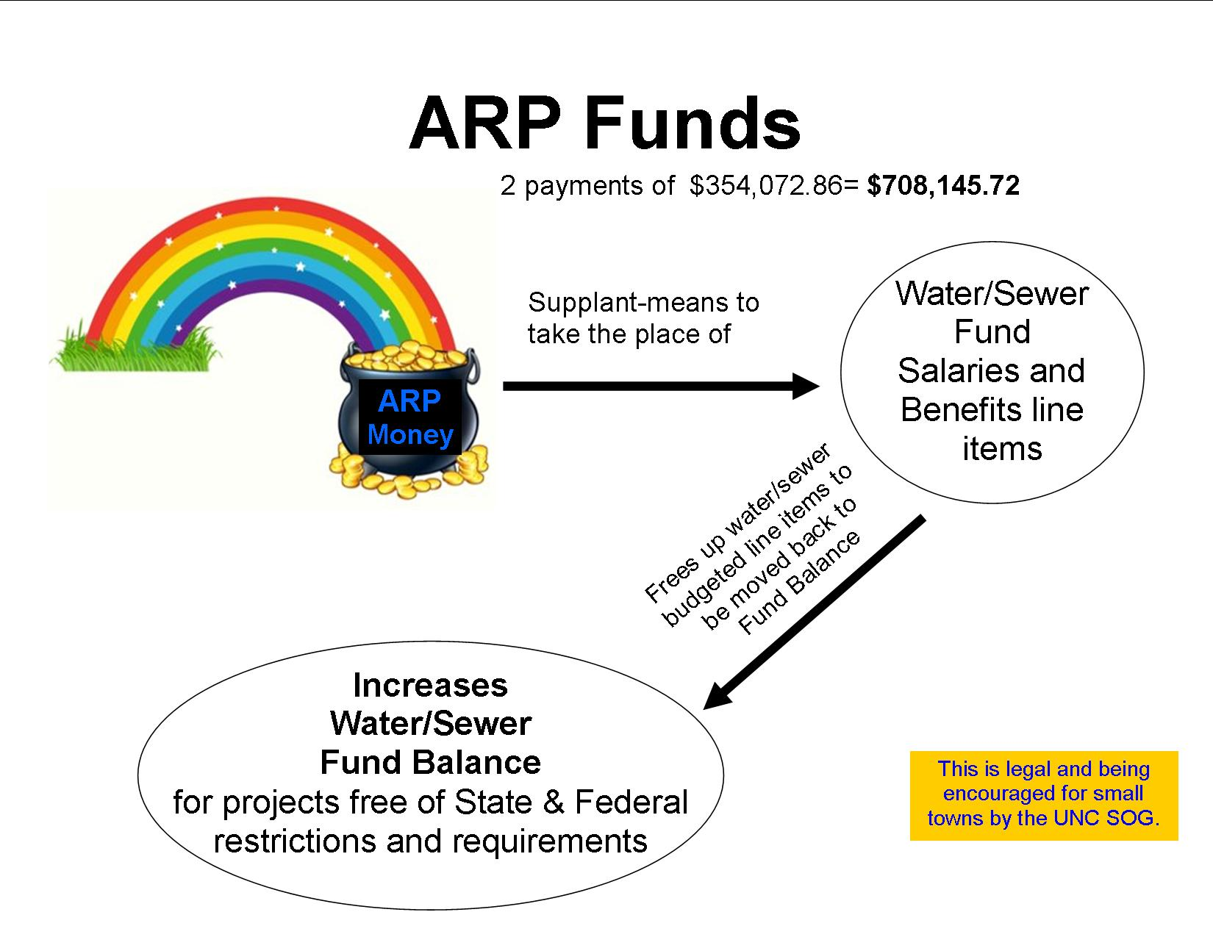

Slide 18
Comprehensive Plan Update by
Erin Burris
Planning & Economic Development Director
See 2022/2023 Budget Workshop Presentation

Slide 19
Municipal Complex Projects
Municipal Park Complex Phase 1: includes a new concession stand with restrooms, picnic shelter, reuse of small electrical building at ball field, new maintenance/storage building, sidewalks from concession stand to playground, covered dugouts on concrete pads, concrete stage pad and additional paved parking.
Future Municipal Park Complex Phase 2 Possibilities: including mini splash pad, downtown connecting walkway, replacing ballfield lights with LEDs and fencing around splash pad.
Based on Current Funding Identified:
Terms: Finance for 20 years @ 3% estimated interest rate
For every million dollars financed- $66,552 in recurring dollars
Current recommended Budget sets aside $65,000
Staff recommends using $300,000 from State Funds for this project to either reduce amount of loan OR to allow us to complete all items in Phase 1 if over projected cost.

Slide 20
Municipal Park Complex Layout

Slide 21
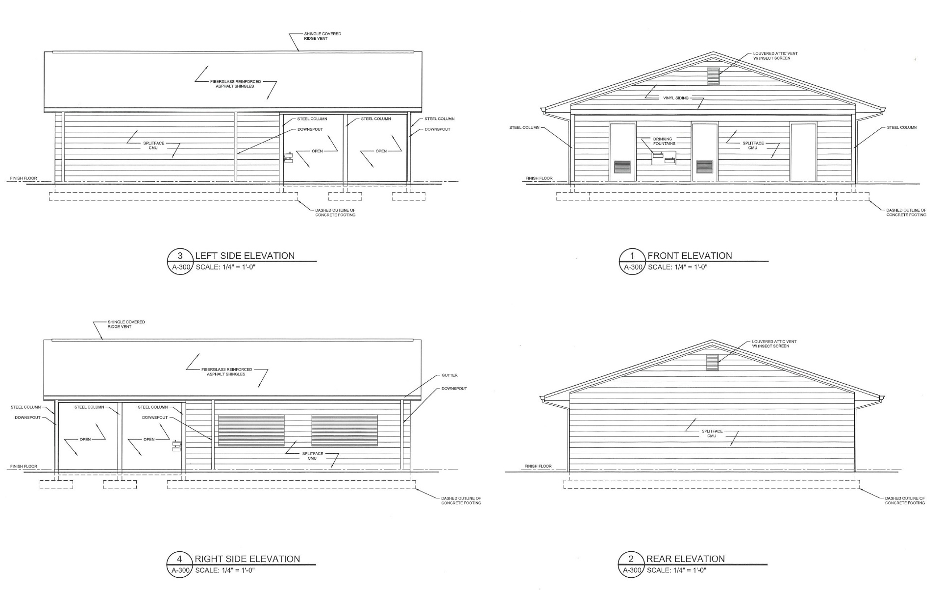

Slide 22
Fire Department Renovation
Project includes:
New addition to rear of existing fire station including 5 bedrooms, storage area, fitness room, and 2 unisex restrooms with showers.
New patio entrance way rear existing station.
Remove existing concrete slab in truck bay area and replace with 8” concrete slab due to deteriorating concrete in truck bay area.
Renovating existing living quarters / kitchen, offices and unisex restroom
New Secure entryway at front of existing station including reception office, antique apparatus bay.
We have $130,000 budgeted for Annual Payment

Slide 23
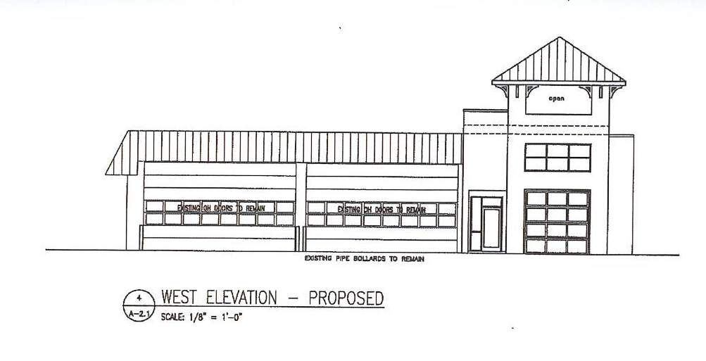
Proposed Fire Station Front

Slide 24
USDA Water & Sewer Project Discussion
Preliminary Project List
12" Water Line-along Main St. (North Drive to Franklin St.) |  | $1,491,000
12" Water Line-along Main St. (Franklin Street to Lee St.) |  | $425,000
12" Water Line-along NC Hwy 49 (North Drive to Hwy 49) |  | $731,000
12" Water Line-along NC Hwy 49 (North Drive to Main St.) |  | $278,000
12" Water Line-along Franklin St (Main Street to Blueberry St.) |  | $1,124,000
Sewer to Eliminate Food Lion PS & Force Main to WSACC |  | $2,321,000
Gravity Sewer – Hwy 49 LS to Food Lion LS $359,000 Gravity Sewer – Hwy 49 LS to Hwy 49 $384,000 New Hwy 49 Lift Station $798,000 10” Force main to Existing WSACC PS $780,000 Sewer Rehab-B St. Area and Manhole Rehabilitation |  | $937,000
Construction Subtotal |  | $7,307,000
Other costs (Legal fees, Permits, Engineering, Contingencies, BAN Interest) |  | $1,898,000
Total Project Budget |  | $9,205,000
Terms: Finance for 40 years @ 2.250% current interest rate
Annual Payment: $351,000 (USDA Project budget is $8 million dollars with an annual payment of no more than $303,496)
Staff anticipates this project will be over budget.

Slide 25
State Budget Projects
Preliminary Project List
List below is total project budgets and includes contingency, engineering, and property/easement acquisition where necessary.
12” Water Line – Cook Street $ 225,000
12” Water Line – West Franklin Street and Skyland $1,055,000
Raw Water Reservoir Relining $ 467,000
Raw Water Intake $ 750,000
Lower Adams Creek Sewer $4,275,000
Lower Adams Creek Interceptor $2,977,000
8” Gravity from Summer Street LS $ 546,000
8” Gravity from Pasture LS $ 752,000
CONSTRUCTION ESTIMATE: $6,772,000
Contingencies and Engineering (25%) $1,693,000
TOTAL COST ESTIMATE: $8,465,000
Project Start Date: Late Fall 2022

Slide 26
Payment Options for USDA
Water/Sewer Projects
Previously discussed in Board Meetings:
Option 2.5: (Board approved June 2021)
FY21/22 Increased base rates by $1.25 PLUS Tier Levels for
excess water use
FY22/23 Increase base rates by $1.25 to all water customers and
Fieldstone flat rate sewer customers for $18,000 in additional
revenue.

Slide 27
Budget Line-Item Discussion & Timeline
Budget line items discussion/questions
Staff will formulate a draft budget as a result of today’s discussions
Board will review what’s proposed
April- budget drafting by staff
May- revisions as need and presentation at May Board Meeting.
June- budget hearing and adoption

Slide 28
Have a Pleasant Weekend!

